Slide 1
Human resources slide 1
FIND YOUR FUTURE AT THE CALIFORNIA STATE UNIVERSITY
FALL 2025 & SPRING 2026
TRANSFER APPLICATION
Notes:
Introduction
Please use this presentation in conjunction with the 2023-24 Freshmen Guide and the Applicant Help Center.

Slide 2
Human resources slide 1
What will we be doing today?
Preparing you to apply to the CSU

Slide 3
Human resources slide 1
Notes:
Navigating to Cal State Apply
Cal State Apply is the central application for all 23 campuses in the CSU. You only need to submit ONE Cal State Apply application even if you are applying for admission into multiple CSU campuses. Keep in mind that each campus you apply to has a $70 fee, so if you apply to multiple campuses you will still only have one Cal State Apply application but will notice you have a higher fee - $70 for each campus you applied to.

Slide 4
Human resources slide 1
What to expect from the CSU admissions process
To apply to the CSU, you’ll be required to:
Complete the Cal State Apply application
Pay the $70 per campus fee (unless fee waiver applies)
Submit any transcripts and required info when notified by the campus
If admitted, register for orientation
** Be aware of important deadlines**
** Check email regularly **
1
2
3
4
Notes:
Apply by the deadline
For information Application Fee Waiver eligibility, visit https://www.calstate.edu/apply/paying-for-college/Pages/fee-waiver.aspx
Campuses will request transcripts and/or information after applications are submitted
Orientations typically take place the summer after high school graduation

Slide 5
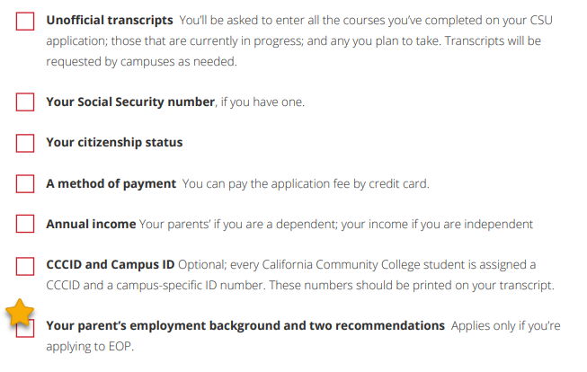
Human resources slide 1
You’ll need this information to apply

Slide 6
Human resources slide 1
The CSU Educational Opportunity Program (EOP)
Provides specialized services and support during your college years like academic counseling and other academic support.
A program designed to help low-income, first-generation students succeed academically in college and graduate.
You are considered First Generation if neither of your parents went to college.
The EOP application is built into the Cal State Apply application. You can submit the Cal State Apply application without the EOP portion complete and come back to it.
The EOP portion has a separate deadline that can vary by campus.
Deadlines are found here: https://www2.calstate.edu/attend/student-services/eop/Pages/eop-campus-status.aspx
Notes:
EOP Admissions site: https://www.calstate.edu/attend/student-services/eop/Pages/default.aspx
Who Can Apply? Only historically low-income, educationally disadvantaged students who need admission assistance and support services to succeed in college are eligible to apply to EOP. They must demonstrate academic potential, motivation to succeed, and meet the income criteria.
What type of student does EOP look for? EOP provides education access and opportunity for low-income and educationally disadvantaged students from California, the majority of whom are first-generation college students. An EOP student may be a special or regularly admissible student who has a low income and has the potential to perform satisfactorily in curricula offered by CSU, but who has not been able to realize his/her potential because of economic, educational or environmental background. Such students may be eligible for admission to a CSU campus through the Educational Opportunity Program.
What services are provided by EOP? A comprehensive program of support services that include advising, learning skills development, tutoring, and academic advisement, the EOP provides educational opportunities to low income students who have been traditionally excluded from higher education. EOP can provide an EOP grant to students who are eligible for financial aid.
Go to the EOP Admission by Term website to see campus deadlines for EOP:
https://www.calstate.edu/attend/student-services/eop/Pages/eop-campus-status.aspx
Applicant Help Center to find out how to edit EOP section after you submit the application: https://help.liaisonedu.com/Cal_State_Apply_Applicant_Help_Center/Filling_Out_Your_Cal_State_Apply_Application/Cal_State_Apply_Supporting_Information/Educational_Opportunity_Program_(EOP)

Slide 7
Human resources slide 1
Materials you’ll need to apply to EOP
Two Recommendations are required to apply
One must be from academic counselor/teacher that can comment on your academic preparedness for university academic work
The other can be from an individual who can comment about your potential to succeed in college.
Recommenders cannot be self or a family member.
You must include their names and email addresses on the application
1
2

Slide 8
Human resources slide 1
Materials you’ll need to apply to EOP
Family Information including
Participation in public assistance programs and other publicly funded programs
Siblings educational information
Household size
Parent/Guardian Information
Occupation information for at least one parent/guardian
Estimated and actual income for this and last year
Household size
Prepare to answer some autobiographical questions

Slide 9
Human resources slide 1
Completing Your Transfer Application
Notes:
Introduction

Slide 10
Human resources slide 1
Applications are open October 1, 2024 and close after December 2, 2024 for the Fall 2025 Semester.
Go to calstate.edu/apply
Select Fall 2025 from the dropdown menu
*Some CSU Campuses may extend their priority application period past December 2, 2024. See the Application Dates & Deadlines page.
Notes:
For more information on the priority application filing period:
https://www.calstate.edu/apply/Pages/application-dates-deadlines.aspx

Slide 11
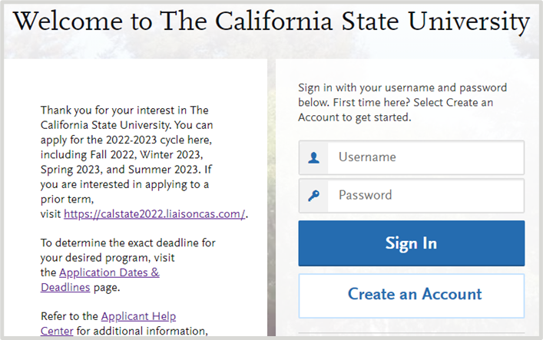
Human resources slide 1
Create your Cal State Apply account
Click Create an Account and fill out information on the Create an Account page
What email address should you use?
Most official CSU communication comes by email
Use/create a personal email address
Check your email regularly
Notes:
Campuses send official communication through email.
Be sure you use and/or create a personal email account (e.g. yahoo, gmail) and use this email on your Cal State Apply account. Do not use your community college email address as it will no longer be available to you once you graduate.

Slide 12
Human resources slide 1
Write down your CAS ID!
Found on top right of screen
Notes:
Be sure to write down your CAS ID. You can access it at any time on the top right of your Cal State Apply application. If you ever need to contact Customer Support or the campus for help, you will be asked to provide this ID number.

Slide 13
Human resources slide 1
Reapplicant Feature
The Re-applicant feature allows applicants to copy data they’ve entered from a prior application year to the current application.

Slide 14
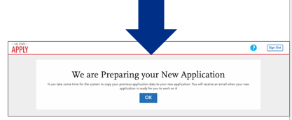
Human resources slide 1
Reapplicant Feature
Applicants emailed when application is available
Not all data can be copied
Check the information carefully after importing and make changes where needed

Slide 15
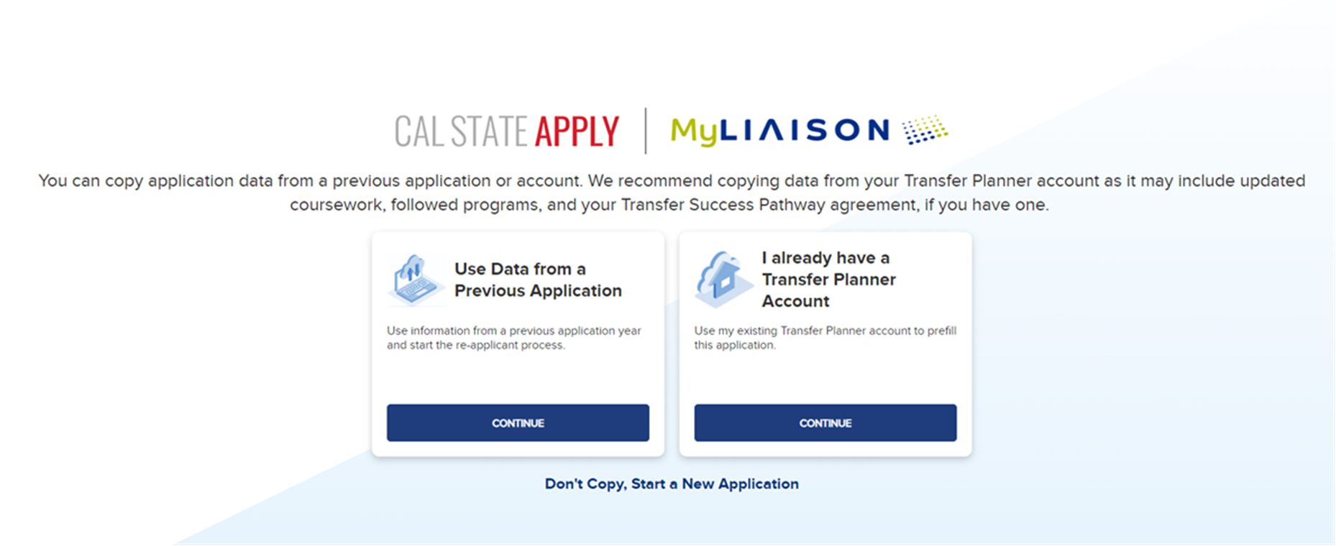
Human resources slide 1
Created a Transfer Planner Account?
If you created a Transfer Planner account, you can transfer courses, standardized tests, programs you follow or signed a TSP agreement with, and some personal information to Cal State Apply!
I already have a Transfer Planner Account → click
CONTINUE

Slide 16
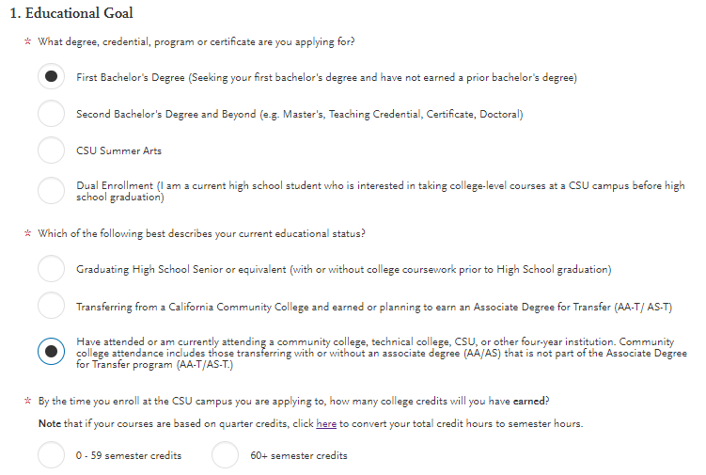
Human resources slide 1
Complete your profile
Educational Goal: First Bachelor's Degree
Current educational status:
Transferring with an AD-T (Associate Degree for Transfer)
Transferring from another college with units completed
0-59 units = lower division transfer
60+ units = upper division transfer
Notes:
The answers you provide on your Extended Profile will determine what questions you are asked for the rest of the application and what programs (majors) will be available to you upon getting ot the point of selection, so be sure to complete this section correctly.
* HELPFUL LINKS * Degreewithaguarantee website to check AD-Ts: https://adegreewithaguarantee.com/en-us/
Cal State Apply AD-T website: https://www2.calstate.edu/apply/transfer/Pages/associate-degree-for-transfer-major-and-campus-search.aspx
Cal State Apply Upper Division Transfer info: https://www2.calstate.edu/apply/transfer/Pages/upper-division-transfer.aspx
Cal State Apply Lower Division Transfer info: https://www2.calstate.edu/apply/transfer/Pages/lower-division-transfer.aspx

Slide 17
Human resources slide 1
Educational Status cont’d
Transferring from a community college or four-year institution
Select if you are a transfer student who will not have earned an Associate Degree for Transfer (AD-T). Even if you have earned an Associate's Degree but not an AD-T, you will select this option.
Most campuses require 60+ units earned by a deadline to be admitted.
If you have courses in progress and/or planned to earn 60+ semester units by the time you enroll at a CSU, select “60+ semester credits”
Notes:
Degreewithaguarantee website to check AD-Ts: https://adegreewithaguarantee.com/en-us/
Cal State Apply AD-T website: https://www2.calstate.edu/apply/transfer/Pages/associate-degree-for-transfer-major-and-campus-search.aspx
Cal State Apply Upper Division Transfer info: https://www2.calstate.edu/apply/transfer/Pages/upper-division-transfer.aspx
Cal State Apply Lower Division Transfer info: https://www2.calstate.edu/apply/transfer/Pages/lower-division-transfer.aspx

Slide 18
Human resources slide 1
Educational Status cont’d
Transfer with an AD-T = Associate's Degree for Transfer
Select if you will have earned an Associate in Arts Degree for Transfer (AA-T) or Associate in Science Degree for Transfer (AS-T).
An Associate’s Degree (AS/AA) is not the same as an AD-T (AA-T/AS-T).
Select the community college where you are earning the degree and the AD-T major
Notes:
Degreewithaguarantee website to check AD-Ts: https://adegreewithaguarantee.com/en-us/
Cal State Apply AD-T website: https://www2.calstate.edu/apply/transfer/Pages/associate-degree-for-transfer-major-and-campus-search.aspx
Cal State Apply Upper Division Transfer info: https://www2.calstate.edu/apply/transfer/Pages/upper-division-transfer.aspx
Cal State Apply Lower Division Transfer info: https://www2.calstate.edu/apply/transfer/Pages/lower-division-transfer.aspx

Slide 19
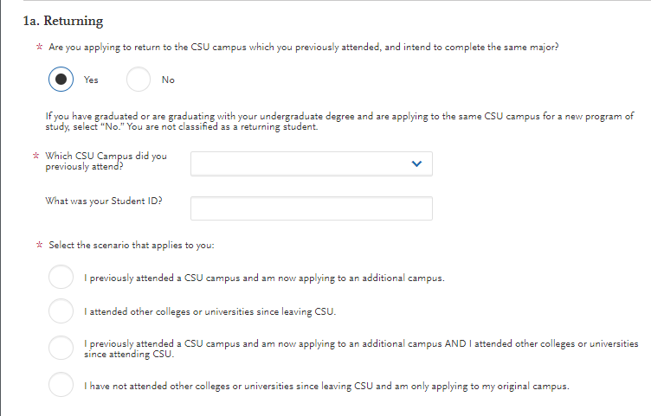
Returning Students
Identify if you are returning to the same campus AND
-have attended other colleges since leaving the CSU
-are applying to additional CSUs in addition to your original campus

Slide 20
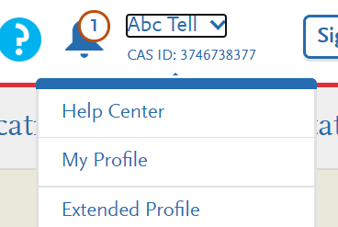
Human resources slide 1
FIND YOUR FUTURE AT THE CALIFORNIA STATE UNIVERSITY
Need to make changes to your profile?
Come back to your questions on the Extended Profile any time to make corrections by clicking your name on the top right-hand corner.
Your Name
Your CAS ID

Slide 21
Human resources slide 1
Select the program(s) you will apply to
Start by typing name of program (major) or campus
You can also use the filter option to narrow down
Select the programs you wish to apply to by clicking the plus button
Program must be undergraduate
You may apply to one program per campus (unsure of which program to choose? You may consider Undeclared/Undecided)
EXAMPLE
Notes:
Common mistake to avoid: applying to the wrong campus. Check the entire name of the campus and program carefully.

Slide 22
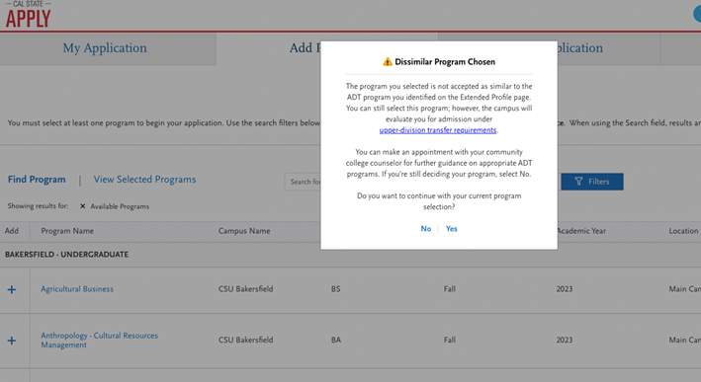
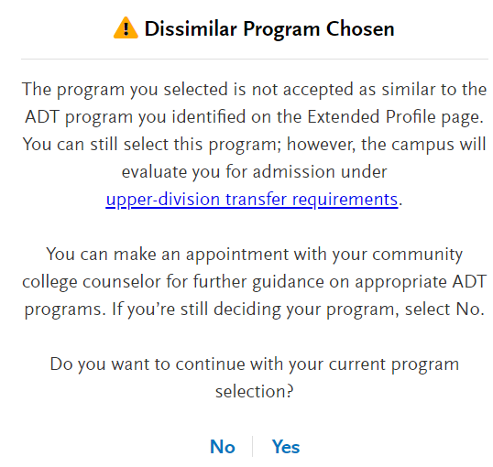
ADT – Dissimilar Program Associate Degree for Transfer Major and Campus Search | CSU (calstate.edu)

Slide 23
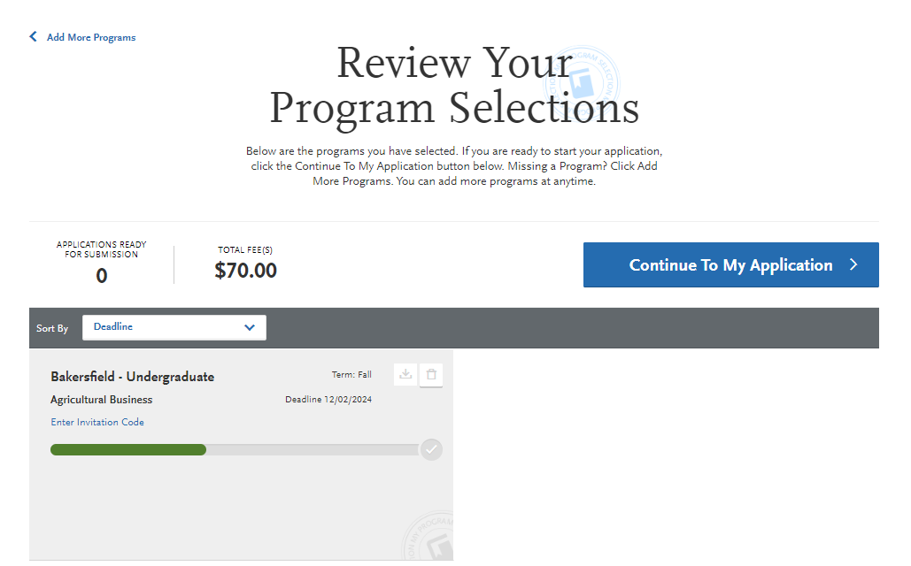
Human resources slide 1
Finish and review your selections
Once ready, click
See your total fees on the top left - $70 application fee will be waived for up to 4 campuses if you meet fee waiver criteria)
Review. Make sure you selected the right campus(es) and program(s).
Select Continue To My Application

Slide 24
Human resources slide 1
Four Sections of the Application
Personal Information
Academic History
Supporting Information
Program Materials
Notes:
The CSU uses self-reported coursework to calculate an overall GPA and to determine admission eligibility. Failure to report all coursework completed may adversely affect admission eligibility and could result in a denial decision.
Supporting information is where the EOP application is found for those who are applying. For those who aren't we will review how to opt out.

Slide 25
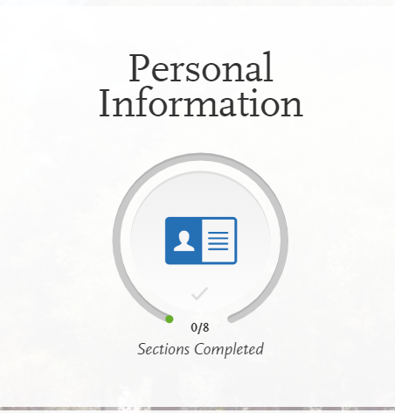
Human resources slide 1
Let’s Complete Part 1: Personal Information

Slide 26
Human resources slide 1
Release Statement
Review the following statements carefully and respond:
Release Statement
CAASPP Results Release Statement
Release of Contact Information
Additional Information Release
Notes:
Review these instructions and the content of the statements carefully. It’s your responsibility to read and understand these statements before responding to them. Once you submit your application, your responses cannot be edited.

Slide 27
Human resources slide 1
Biographic Information
Complete the biographic information section.
Your legal name should match the name given on your high school transcript
Report former or preferred names (voluntary)
The sexual orientation question is optional/voluntary.
DOB pop up message will appear to confirm your age
Any changes you make after you submit your application must be sent to each campus that you applied to.
Notes:
Legal Sex
Select responses to subsequent questions regarding sexual orientation, gender identity, and gender expression.
Your responses are for informational purposes only. No information provided will be used in a discriminatory manner or affect your application for admission. The CSU collects this voluntary demographic information regarding the sexual orientation, gender identity, and gender expression of students (California Education Code section 66027, AB 620). Please note the following:
Providing this information is optional and not required to move forward or complete the Cal State Apply application for admission.
Your responses are kept private and secure. Limited campus staff will have access to this information.
This data will not be used for discriminatory purposes.
This information is used to provide services to all our student populations.
This information is used for summary demographic reporting in which no individual applicant's identity will be revealed. In compliance with the California Education Code, this summary information will be made available on CSU and campus websites and to the California Legislature.
Applicant information (undergraduate)
This section only applies to undergraduate applicants. Your responses to questions in this section help CSU provide services to students. All questions are optional.

Slide 28
Human resources slide 1
Contact Information
Complete the contact information section.
Current address =
This should be where you want to receive mail correspondence
Is your permanent address different than your current address?
If so, select No to "Is this your permanent address?“ Enter current address
Notes:
If you don’t have a mailing address, you can list the address of a relative or friend, with their permission. If you find more permanent housing in the future, please update it in your application and with the campuses you applied to.

Slide 29
Human resources slide 1
Citizenship/Residency Information
Citizenship and residency information will not be used to determine your eligibility for admissions but may be used to help provide you with additional support and used for items like determining tuition and fee rates.

Slide 30
Human resources slide 1
Citizenship/Residency Information
***For those who selected No earlier to "do you have or will you require an F1 or J1 Visa to study at the CSU?"***
US Citizen: born in the US or attained citizenship through naturalization
Permanent US Resident: holds a green card or is an applicant for a green card and is permitted to permanently live and work in the US
None: no US Citizenship
Refugee: forced to leave country in order to escape war, persecution, or natural disaster
Other Visa: holds a Visa other than F1 (student) or J1 (exchange) - You will be prompted to choose which Visa if you select this option
Other nonimmigrant status: entered the U.S. on a temporary basis such as work, tourism, business, or study - You will be prompted to choose which status if you select this option
US Citizenship

Slide 31
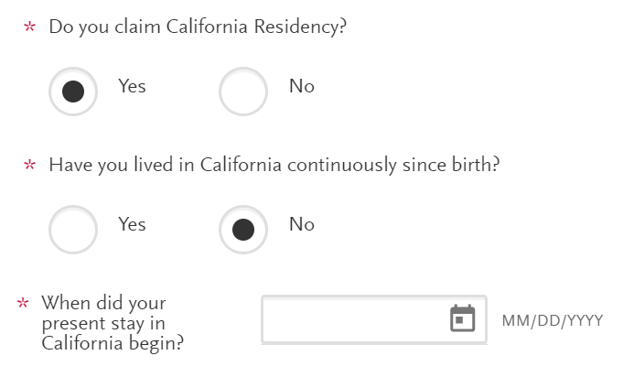
Human resources slide 1
Citizenship/Residency Information
***For those who selected No earlier to "do you have or will you require an F1 or J1 Visa to study at the CSU?"***
The US state/possession you regard as your permanent home is filled in from earlier; to update, go to Extended Profile
If your permanent home is California, you'll be prompted to:
Indicate whether you claim California residency
Indicate if you've lived in CA continuously since birth (If no, you'll be asked to give the date your stay began)
Residency

Slide 32
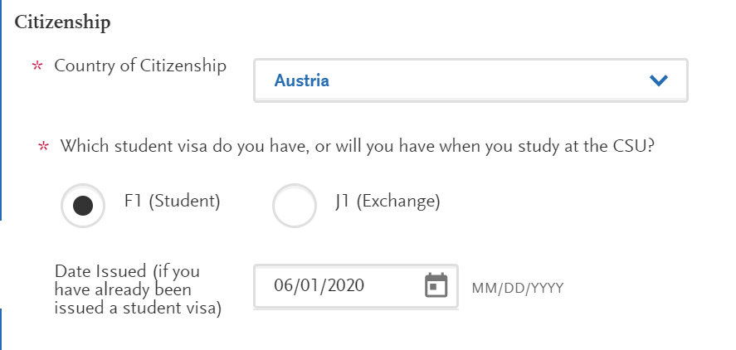
Human resources slide 1
Citizenship/Residency Information
***For those who selected Yes earlier to "do you have or will you require an F1 or J1 Visa to study at the CSU?"***
Select your country of citizenship and the Visa type you have or will have when you study at the CSU (F1 or J1 Visa)
If you already have a visa, enter the date it was issued
Citizenship (for International Applicants)

Slide 33
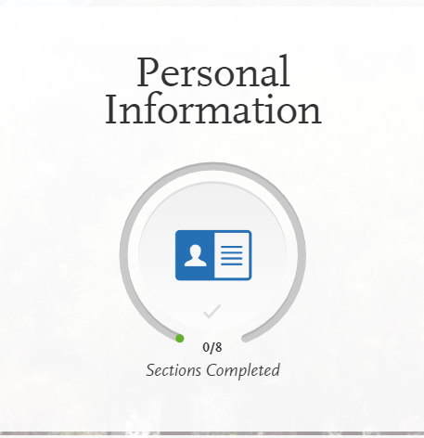
Human resources slide 1
Race & Ethnicity
Complete the questions on this section.
This section will not be used to determine eligibility for admissions.
This information may be used to help provide you additional support.

Slide 34
Human resources slide 1
Parent / Guardian Information
If you are a dependent, you must enter at least one parent / guardian's information in this section.
If you are considered independent, you can opt out of this section if you wish.
Unsure of how to answer at this moment? You can move onto the other sections and come back to this later. You cannot submit your application until you complete this section.

Slide 35
Human resources slide 1
Other Information
Social Security (SSN)
Carefully type in your SSN if you have one.
Incorrect or missing information could delay your admission or require you to turn in additional documentation.
Enter your SSN If you have qualified for DACA and been issued a SSN.

Slide 36
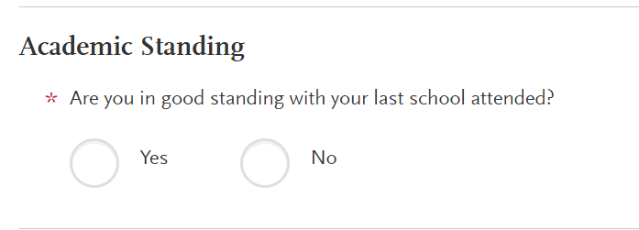
Human resources slide 1
Academic Infractions and Conduct
Academic infractions such as probation, disqualification, etc. are typically notated on your college transcript(s)
Notes:
SSID has been moved under the SSN field to assist with applicants understanding that this is not their SSN.

Slide 37
Human resources slide 1
Financial and Parental Information
Complete this section. This information is not used to determine financial aid eligibility and is used for information purposes only.
Read the Household Income and Size Information carefully as your answer will determine what other information you will have to provide here.
Any of the statements apply? You are considered Independent
None of the statements apply? You are considered Dependent
Notes:
If you cannot answer Yes to any of the above questions, you are considered a dependent student. Provide the following information about your parent/guardians' household. Be sure to enter your information accurately as this section cannot be updated after submission.
Total size of parent/guardians' household in the specified year. Note that your parent/guardians' household includes your parents/guardians (or registered domestic partners), yourself, other dependent children, and other dependents. The total size should be greater than one.
Parents' adjusted gross income (AGI) for the specified year. Adjusted gross income can be found on your federal tax return as follows:
Form 1040: Line 37
Form 1040A: Line 21
Form 1040EZ: Line 4
Untaxed income and benefits for the specified year. Untaxed Income is income not reported on a tax return, such as:
Child support.
Untaxed portions of pensions.
Housing, food, and other allowances paid to military, clergy, and others, including cash and cash value. Do not include the value of military on-base housing or the value of a basic military allowance for housing.
Veterans – non-education benefits including Disability, Death Pension, or Dependency & Indemnity Compensation (DIC) and/or VA Educational Work-Study allowances.
Other untaxed income such as worker’s compensation, disability benefits, etc.
Parents' untaxed income and benefits for the specified year.
Don’t include extended foster care benefits, student aid, earned income credit, additional child tax credit, welfare payments, untaxed Social Security benefits, Supplemental Security Income, Workforce Innovation and Opportunity Act educational benefits, on-base military housing or a military housing allowance, combat pay, benefits from flexible spending arrangements (e.g., cafeteria plans), foreign income exclusion, or credit for federal tax on special fuels.

Slide 38
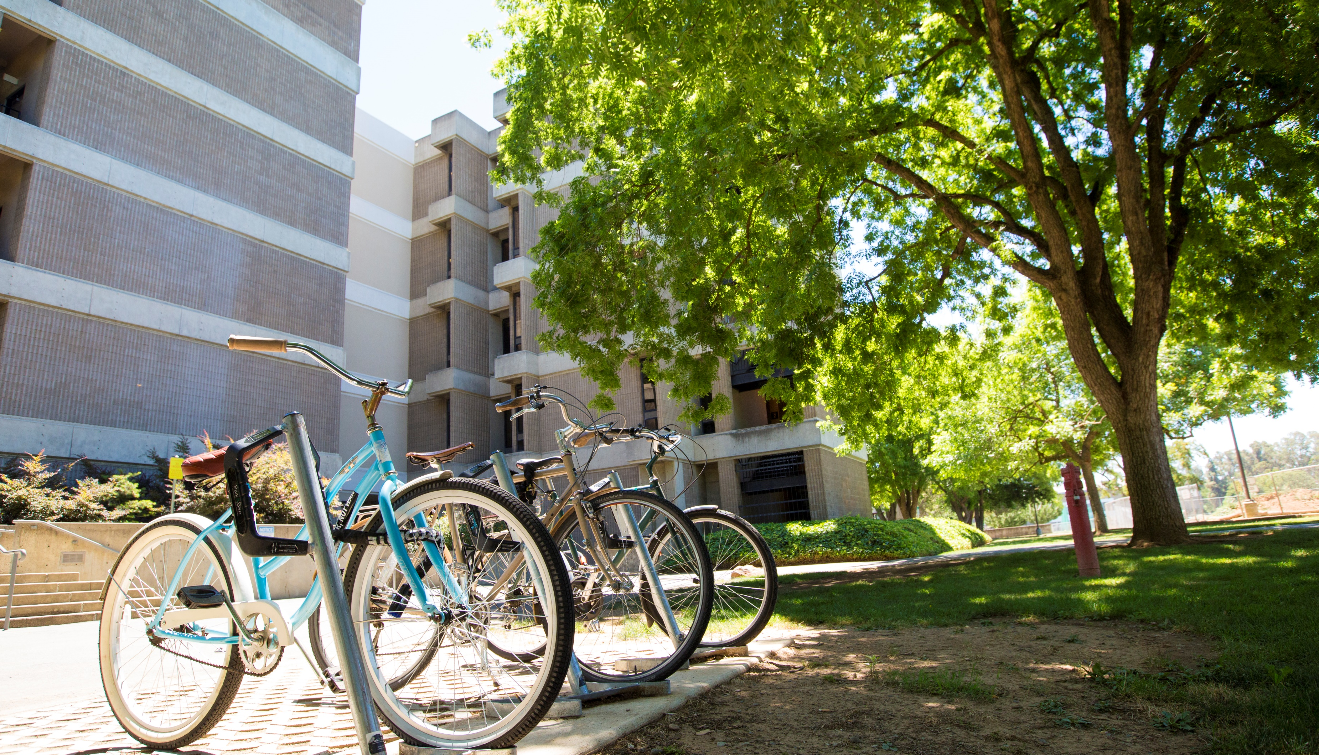
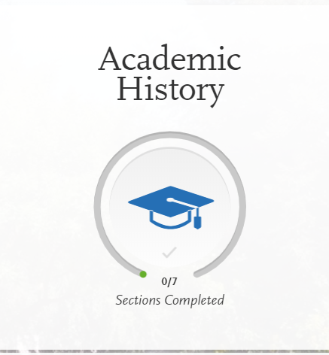
Human resources slide 1
Let’s complete Part 2: Academic History

Slide 39
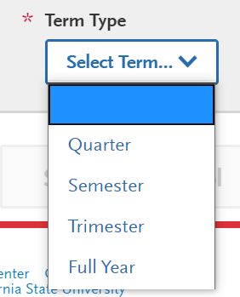
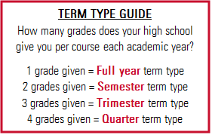
Human resources slide 1
High Schools Attended
For term type, select the term type based on how many grades you earned per course in a year
Attend a high school with multiple term types? Report the high school more than once and select a different term type for each entry
Unsure of your term type?
See our Term Type Guide!
Notes:
HIGHLIGHTS ABOVE ARE FOR PRESENTER TO ENTER YOUR SPECIFIC INFORMATION BASED ON THEIR SCHOOL
Save time uploading your transcripts using CaliforniaColleges.edu:
California residents that have a CaliforniaColleges.edu account can use this account to add high school transcript information to their application. View this how-to video about importing your courses.
If your school changed term types for one year or more, have students add the school twice with each respective term type.

Slide 40
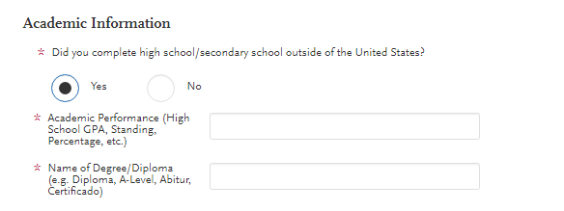
Human resources slide 1
Academic Information
Select No unless you completed high school/secondary school and it was outside of the US
Select Yes if you completed high school/secondary school outside of the US
Academic Performance
Name of diploma or equivalent

Slide 41
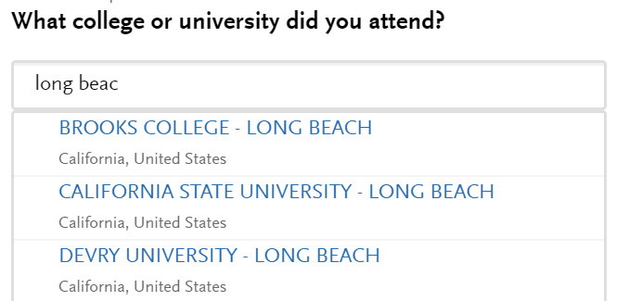
Human resources slide 1
Colleges Attended
Report all colleges attended.
Start by selecting
Then, start typing in the name of the college/university and options should begin to appear.
Select the college you attended from the options

Slide 42
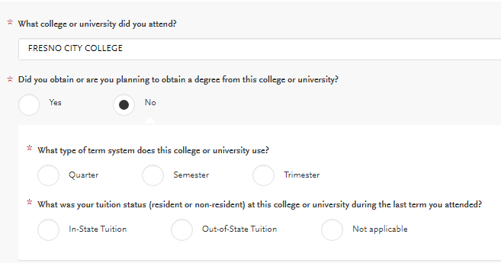
Human resources slide 1
Colleges Attended
Select No if you are not earning an associate’s degree while simultaneously enrolled in high school
Select the term system
California resident? Select in-state tuition for tuition status

Slide 43
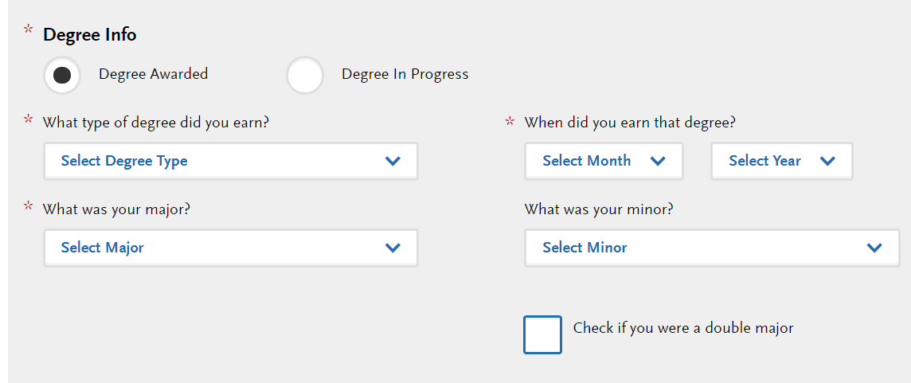
Human resources slide 1
Colleges Attended – Degree Information
Select Yes if you will have earned a Certificate, Associate’s Degree, or an AD-T
Select Degree Awarded if you will have earned it before starting at the CSU
Report Dates of Attendance. If you have attended another college, click SAVE and then click
Notes:
Degree Information: If you identified yourself as an Associate Degree for Transfer (AD-T) student in the Extended Profile questions on your application, then be sure to select the appropriate degree from the list here – either an Associate of Arts for Transfer (AA-T) or an Associate of Science for Transfer (AS-T). You should not select these options if you have not completed or will not complete an approved Associate Degree for Transfer (AD-T).

Slide 44
Human resources slide 1
College Coursework
Report all courses completed on your transcripts for all colleges attended. This includes:
Withdrawals
Repeats
Ungraded labs
Test credits
Gym courses
Orientations
Other non-graded courses
Even if non-transferrable
All colleges you reported attending will appear in the College Coursework section.
Click to enter transcripts for each college.
Notes:
Important note: Use official copies of your transcripts. Coursework must exactly match your official transcripts; don't use an unofficial version, like a printout from your school's website. List your courses under the correct term, year, and class level. Department prefixes and course numbers must precisely match those on your transcripts.

Slide 45
Human resources slide 1
College Coursework
To begin entering college courses for each college you attended, click
Click Add a Semester (or Trimester or Quarter)
Select the Term, Year, and Completion Status (e.g., completed, in progress, planned)
Click
Enter the course code (e.g., BIO2)
The course title & course credits should prepopulate based on course code
Enter the grade you received
Make sure the TRANSFERABLE box is checked
SAVE

Slide 46
Human resources slide 1
College Coursework
Type of Credit | Grade to enter
Credit from Academic Renewal | Grade: AR
Course repeat (excluded from GPA) | Grade: RP for the original course
Currently repeating a course | Grade: Enter the original grade you earned (and mark repeated course as in progress)
Credit from Pass/Fail course | Grade: P

Slide 47
Human resources slide 1
Entering General Education (GE)
Select what courses you took to complete “Golden Four” based on courses you entered in Transcript Entry section
If you took more than one course for the GE area, pick one with grade C or higher (or pass/credit)
ADT and Upper Division transfers cannot opt out
Lower Division transfers cannot opt out of Written Communication nor Math Concepts/Quantitative Reasoning
You cannot edit this once you submit

Slide 48
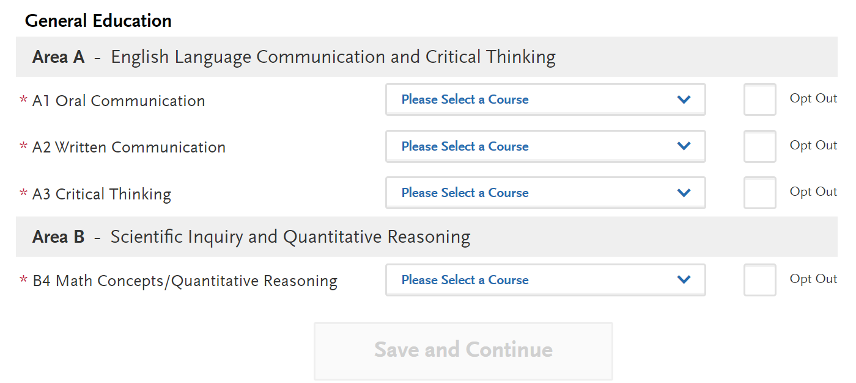
General Education: The Golden Four GE courses will prepopulate for California community colleges if courses were entered using the prefill options
LDT applicants may opt out of A1/A3

Slide 49
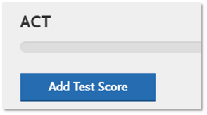
Human resources slide 1
Standardized Tests (ACT, SAT, TOEFL, AP, IB, CLEP)
Standardized tests will not be used to determine admissions eligibility.
These scores may still be used to help place you in math and English courses when you enroll
You can enter your ACT, SAT, AP, IB, CLEP, TOEFL exams you have taken or are planning to take
No tests to report? Click
Notes:
Common mistake to avoid for reporting ACT and SAT: Accurately report your ACT ID and College Board ID
Be sure to accurately report your ACT ID (for the ACT exam) or your College Board ID (for the SAT exam). This is the easiest and best way to ensure your scores will be matched to your application and received by the CSU campus(es) you apply to.
For more information about F21 and standardized test scores, please visit the First-time Freshman Frequently Asked Questions page of the website.

Slide 50
Human resources slide 1
About Part 3: Supporting Information

Slide 51
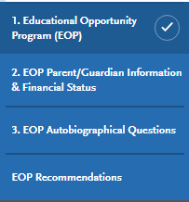
Human resources slide 1
Overview of the EOP Application
Section 1: General questions
Section 2: Parent/Guardian Information & Financial Status
Section 3: EOP Autobiographical Questions
Section 4: Contact information for two people who will complete your recommendations

Slide 52
Human resources slide 1
Indicate if you will apply to EOP
“Do you wish to apply to EOP?”
Not applying to EOP? Click No. You are done with Section 3 of your application.
Applying to EOP? Click Yes, I will return later to complete these EOP Questions.
Applying to EOP Now? Click Yes

Slide 53
ADT Information
Report your:
Campus ID
CCC ID
Anticipated or Completed ADT Degree Date

Slide 54
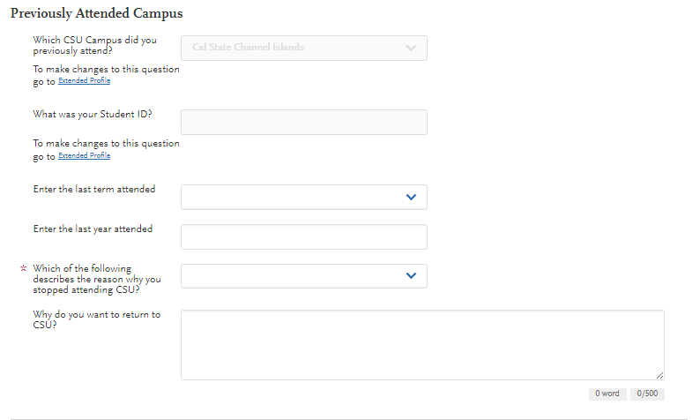
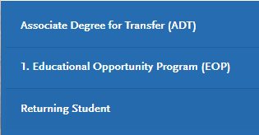
Human resources slide 1
Returning Student tile
Pulled from the Extended Profile. Helps the campus gather information about why you stopped attending

Slide 55
Human resources slide 1
Let’s complete part 4: Program Materials

Slide 56
Human resources slide 1
Program Materials
Depending on the campus and major (“program”) you choose, there may be required items to complete. Check for multiple tabs.
Once you’ve read through and responded to anything in this Program Materials section, you can exit back to My Application on the top left
Notes:
For each program you are applying to, you will see one blue tile. So, if you are applying to two programs, you will see two tiles. If the program has mandatory responses or documents to upload then it will not let the applicant submit without those.

Slide 57
Human resources slide 1
Program Materials
Financial Aid Housing Question
This question is not used to determine admission eligibility. This question helps campuses determine financial aid.
If you apply to more than one program, you will answer this question for every campus program in your shopping cart
Notes:
For each program you are applying to, you will see one blue tile. So, if you are applying to two programs, you will see two tiles. If the program has mandatory responses or documents to upload then it will not let the applicant submit without those.

Slide 58
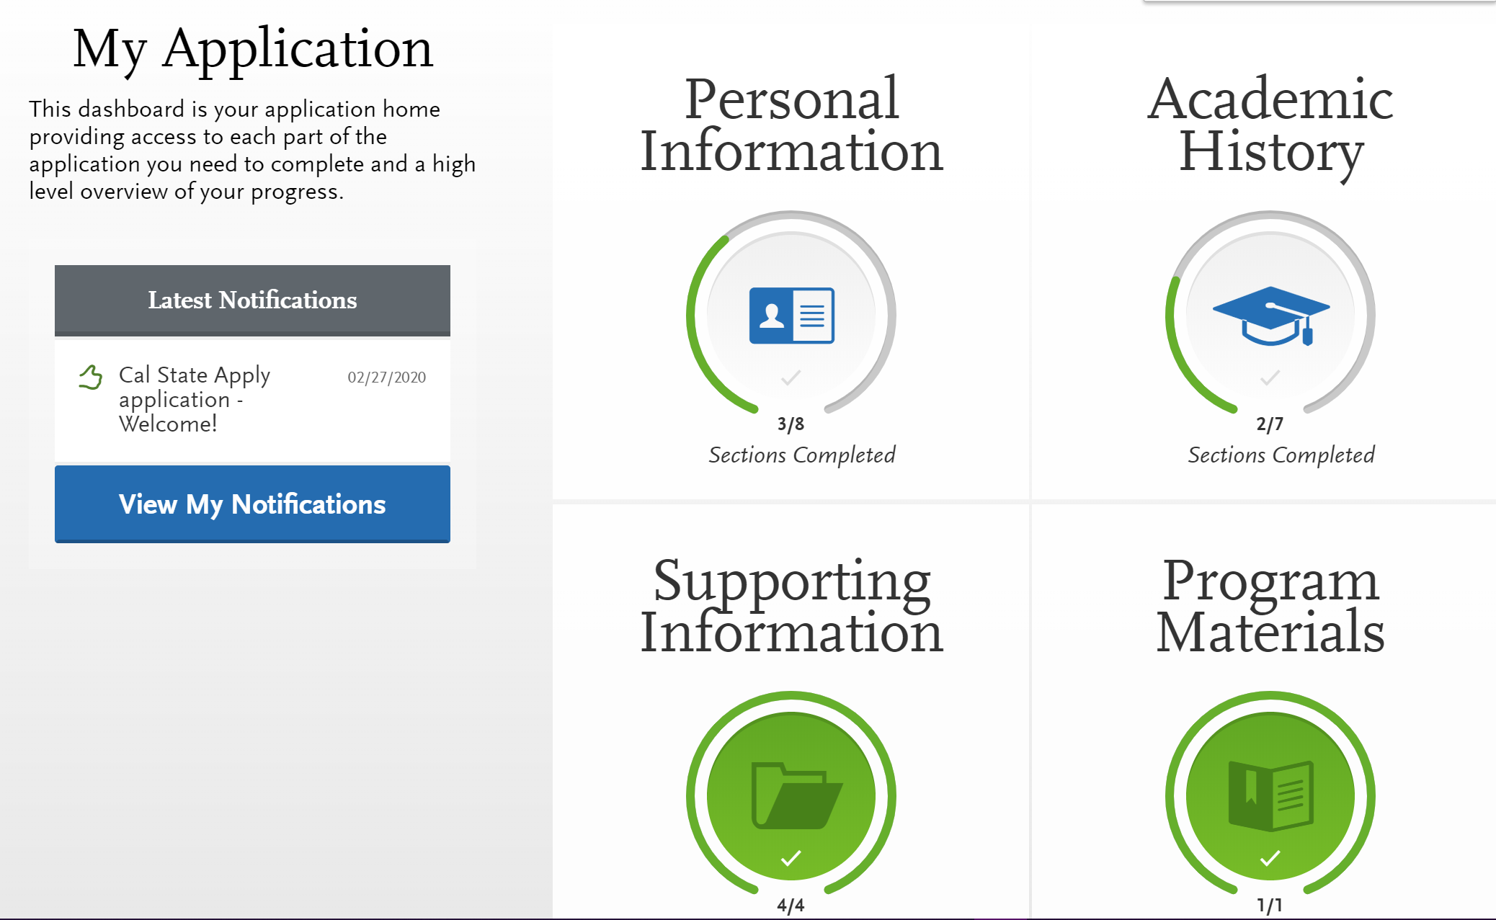
Human resources slide 1
You must complete all sections of the application before submitting
Note: If you selected “Yes I will return later to complete EOP” in the Supporting Information section, you may return to the application after submitting to finish EOP. Be mindful of campus EOP deadlines!
Incomplete
Complete
Completed sections of the application will highlight green.
Notes:
Once submitted, your application cannot be changed with exception of adding new test scores or adding information for the EOP application (see FAQs). Incomplete or inaccurate information may affect admission eligibility. If you do need to make a change, please contact the campus you applied to directly.
You are ready to submit when the four quadrants show complete (green) and when the status on the program (in the Submit Application tab) has also turned green

Slide 59
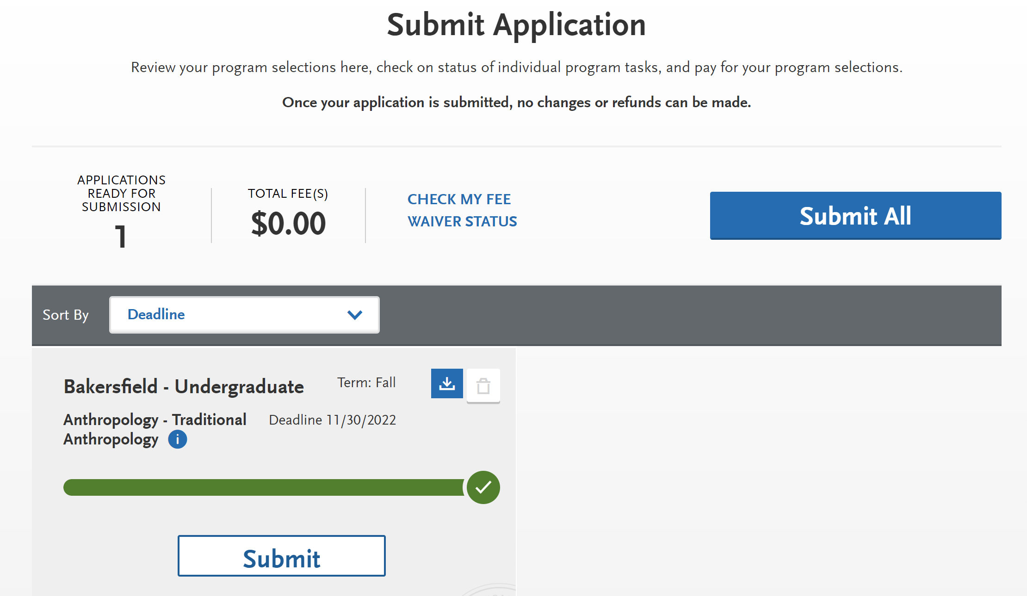
Human resources slide 1
Before Submitting
Check total fees and # of applications ready to submit
REMINDER: No changes can be made after submission besides EOP application and new test scores
EXAMPLE
Notes:
Review your programs. You can remove a program by clicking the red X. This is the last chance to review, so please do it carefully. There are no refunds issued if you make a mistake.
When ready, click continue and note the Fee Total. Here, enter payment details including credit card and confirm your billing address. Select Continue to proceed with payment processing.
Fee Waivers
A fee waiver is automatically generated based on the information you provided in the application. You must fully complete the application before the fee waiver eligibility is determined. Select Check My Fee Waiver Status on this Submit Application tab to view your eligibility.
For information Application Fee Waiver eligibility, visit https://www.calstate.edu/apply/paying-for-college/Pages/fee-waiver.aspx

Slide 60
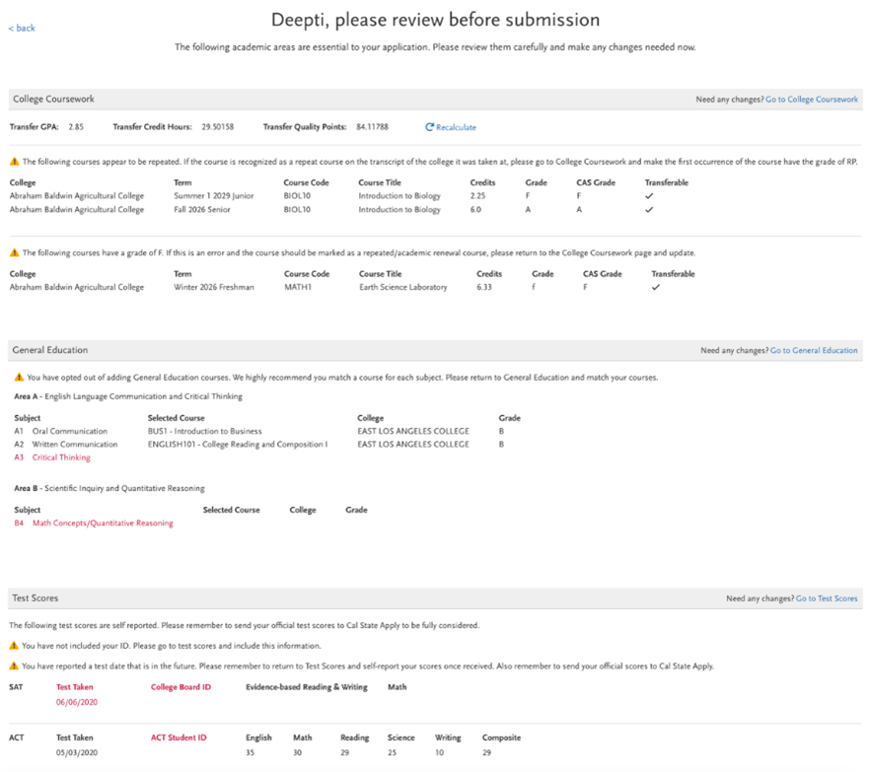
Human resources slide 1
WAIT: Review the SUMMARY PAGE carefully!
Note any warning messages
Note any red text
Update/fix and missing or incorrect info before submitting
EXAMPLE
Notes:
Review your programs. You can remove a program by clicking the red X. This is the last chance to review, so please do it carefully. There are no refunds issued if you make a mistake.
When ready, click continue and note the Fee Total. Here, enter payment details including credit card and confirm your billing address. Select Continue to proceed with payment processing.
Fee Waivers
A fee waiver is automatically generated based on the information you provided in the application. You must fully complete the application before the fee waiver eligibility is determined. Select Check My Fee Waiver Status on this Submit Application tab to view your eligibility.
For information Application Fee Waiver eligibility, visit https://www.calstate.edu/apply/paying-for-college/Pages/fee-waiver.aspx

Slide 61
Human resources slide 1
When you’re ready, click Submit All or click Submit to submit to one program
Submit your payment details (if you did not qualify for waivers)
Check your email regularly for any updates from the campus(es)
You can log back into your Cal State Apply application after submitting but may only update limited information
Notes:
Where/how will I receive the admissions decision?
The admissions decision will NOT be found within Cal State Apply. You will hear directly from the campus (usually via the email you used to apply) regarding your admissions decisions.
What if I’m not admitted to the CSU campus(es) I apply to?
If you are a first-time freshman, upper-division transfer student or an Associate Degree for Transfer (ADT) student applying to the CSU and you are a California resident for tuition purposes, CSU-eligible and have not been admitted to any CSU to which you applied, there is the chance that the campus(es) you applied to don’t have the capacity to admit more students.
If this happens, you will be redirected to an alternate CSU campus. This is called redirection. You would receive the redirection details via email from Cal State Apply. For more information, please visit https://www2.calstate.edu/apply/redirection.

Slide 62
Human resources slide 1
Questions?

