Slide 1
Academic Planning Summit
Degree Proposal, Review and
Approval Process
June 6, 2017
CSU Chancellor’s Office
Notes:
The California State University

Slide 2
Design: Sources and Resources
Title 5
CIP Code
Accreditation Standards
Current Discipline Research
Employment Statistics
Industry Projections or Community Advisories
Curriculum from Comparable Programs

Slide 3
Developing the Degree Proposal
Degree Proposal Template
Tips Document
http://www.calstate.edu/app/
Link: New Program Development
Program Proposal Template and Tips 2017

Slide 4
Sections of the Template
Program Type
Program Identification
Program Overview and Rationale
Curriculum*
Societal and Public Need
Student Demand
Existing Support Resources
Additional Support Resources Required
Self-support Programs*

Slide 5
Section 4: Curriculum
Assessment
Curriculum Map

Slide 6
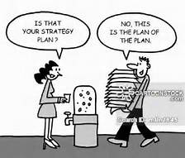
Comprehensive Assessment Plan

Slide 7
Sample – MS Nutrition

Slide 8
http://www.calstate.edu/app
Where is the comprehensive program assessment plan template located?

Slide 9
What if we don’t change at all and something magical happens?

Slide 10
Curriculum Map Template

Slide 12
Sample Curriculum Map

Slide 13
Program Proposal Review Criteria - Highlights
What do reviewers look for?

Slide 14
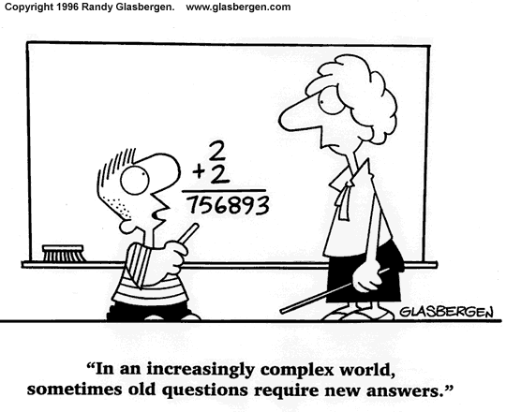
Complete
Succinct responses to the prompts
Coherent catalog description
clear admission requirements
all required courses listed
accurate unit counts

Slide 15
Assessment Plan
all assessment sections addressed
measureable SLOs
activity to measure learning outcome is VALID

Slide 16
You will be evaluated on how well you handle this thing.

Slide 17
Example of a non-measureable SLO
Students will develop an appreciation for and understand the development of psychological theories, including their origins.

Slide 18
Example – Measurable SLO and Invalid Assessment Activity
SLO: Students will describe and summarize the
development of psychological theories, including their origins and alterations.
Assessment: True/False Exam

Slide 19
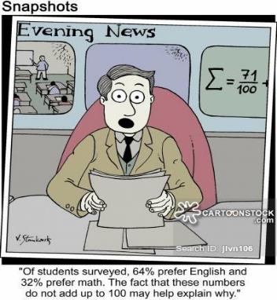
Student Demand
compelling evidence
surveys – current data
petitions
enrollment trends
letters
Approvals
documentation with signatures

Slide 20
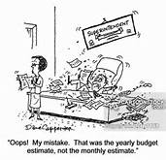
Self-Support
criteria to qualify as self-support are met
complete and reasonable
budget with accurate calculations

Slide 21
Campus Perspective
Elizabeth Adams
Associate Vice President, Undergraduate Studies
CSU Northridge

Slide 22
Campus Perspective
AVP role
Typical assistance needed
Approval process
Facilitation of CO feedback
Additional perspectives

Slide 23
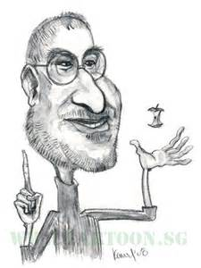
Just one more thing!

Slide 24
Contracts Associated with Degree Programs
Include copies of any contracts or agreements made between parties with an interest in operating the proposed program.
Other parties may include academic departments, academic institutions, foundations, vendors or similar. Please include a copy of the agreement and an e-mail or other evidence that the campus attorney has approved the agreement.

Slide 25
4+1 Programs (Blended)
For specific information, please
check the handout in the folder.

Slide 26
Important Words
Simplify
Simplify
Simplify

Slide 27
Questions?
Audience Participation

